Slide 1

Computer System
安希佐 4110E229 My Dear Great Teacher

Slide 2
AGENDA
Computer System
Von Neumann Architecture
Computer hardware
Computer software: Operating system
Memory Hierarchy What is RAM? ROM? Differences between the two What is SRAM? DRAM? Differences between the two

Slide 3
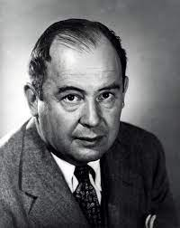
Von Neumann architecture
In "First Draft of a Report on the EDVAC," John von Neumann described the structure of a stored-program computer. He put forth a notion that has been a part of standard computer architecture since 1945.
The following components of the design architecture for an electronic digital computer are described in the document:
a processing unit containing both processor registers and an arithmetic logic unit
a control unit with a program counter and an instruction register
Memory for storing information and commands
External mass storage
Input and output mechanisms

Slide 4
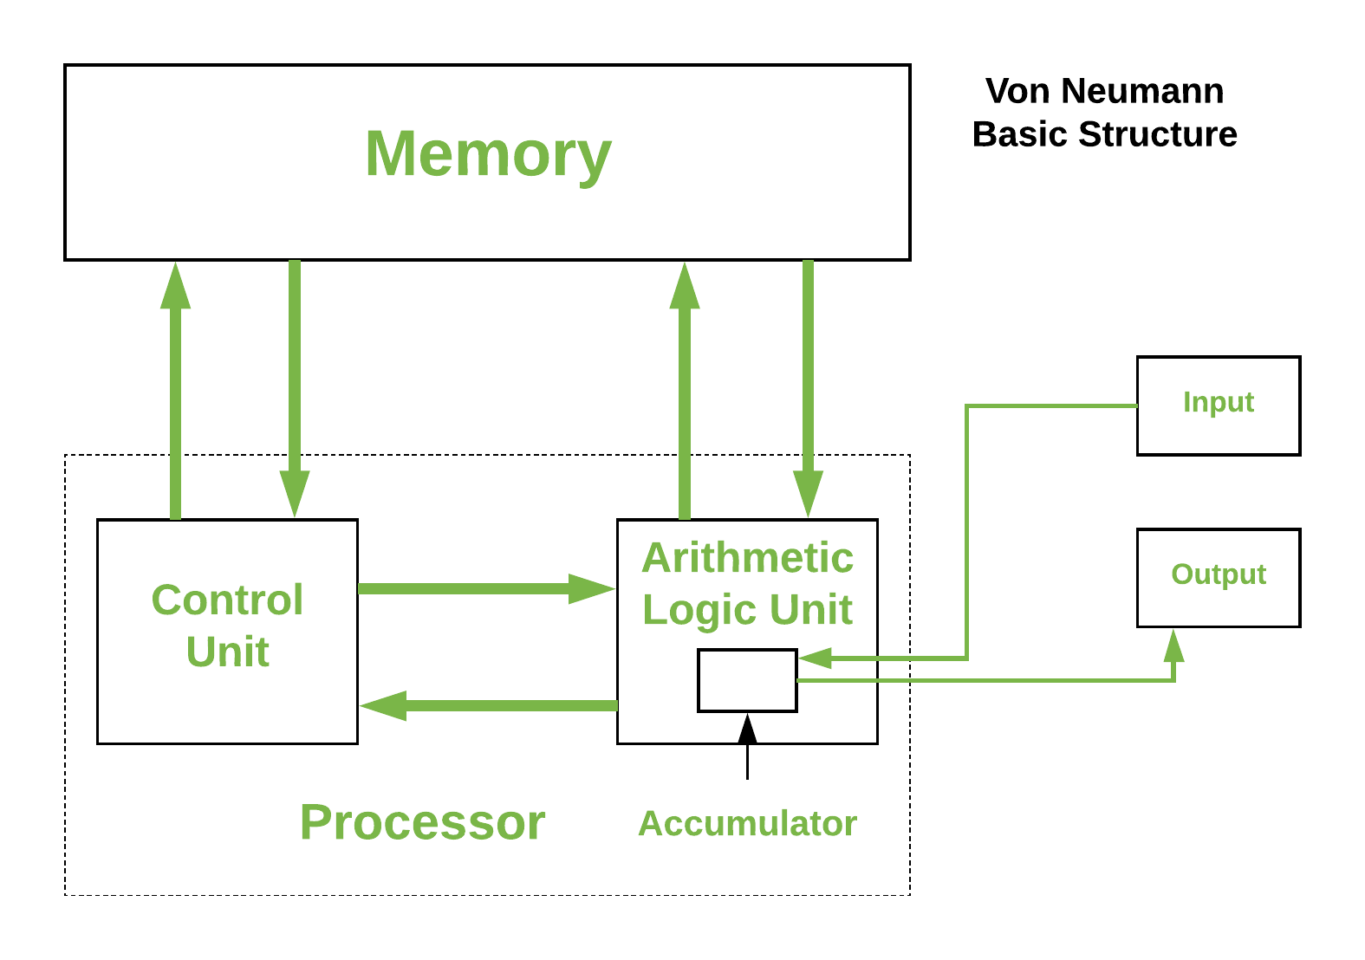
Von Neumann architecture
A stored-program computer that prohibits simultaneous execution of a data operation and an instruction fetch is referred described as having a "von Neumann architecture" (since they share a common bus). The performance of the related system is frequently constrained by this, known as the von Neumann bottleneck. A Harvard architecture machine, which is similarly a stored-program system but has one specialized set of address and data buses for reading from and writing to memory and another set of address and data buses for fetching instructions, has a more complex design than a von Neumann architecture machine.

Slide 5
What is a Computer System?

Slide 6
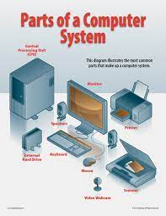
A computer system is a nominally complete computer that includes the necessary hardware, operating system (main software), and peripheral equipment for full operation. This term can also refer to a collection of computers that are linked and work together, such as a computer network or a computer cluster.Computers are used as control systems in a wide range of industrial and consumer products. Simple special-purpose devices such as microwave ovens and remote controls, as well as factory devices such as industrial robots and computer-aided design, are included, as are general-purpose devices such as personal computers and mobile devices such as smartphones. The Internet is powered by computers, which connects billions of other computers and users.

Slide 7
Major types of a Computer System?

Slide 8
Microcomputer system

Slide 9
Microcomputers are the most popular type of computer system among end users. A microcomputer, though commonly referred to as a personal computer, or PC, is much more than a small computer for personal use. Microcomputer computing power now exceeds that of previous computer generations' mainframes at a fraction of the cost. As a result, they have evolved into powerful networked professional workstations for business end users.

Slide 10
Multimedia Computer Systems

Slide 11
Multimedia PCs are intended to display information in a number of media formats, such as text and graphics displays, voice and other digital audio, photos, animation, and video clips. Many people associate multimedia with computer video games, multimedia encyclopedias, educational videos, and multimedia home pages on the World Wide Web. Multimedia systems, on the other hand, are frequently utilized in business to train staff, educate customers, make sales presentations, and add impact to other business presentations. The basic hardware and software requirements of a multimedia computer system are determined by whether you want to create and view multimedia presentations. In order to enjoy multimedia games and other entertainment and instructional multimedia items, owners of low-cost multimedia PCs aimed for home use do not require authoring software or high-powered hardware capacity. These computers include a CD-ROM drive, stereo speakers, more memory, a high-performance processor, and other multimedia processing features.

Slide 12
Midrange Computer Systems

Slide 13
Midrange computers, which can handle a network of PCs and terminals, include minicomputers and high-end network servers. Though not as powerful as mainframe computers, they are less expensive to purchase, operate, and maintain, and so satisfy the computing demands of many enterprises. Midrange computers first gained popularity as minicomputers for scientific research, instrumentation systems, and monitoring and control of industrial processes. Minicomputers could readily handle such applications since they are limited in scope and do not require the processing versatility of mainframe systems. Midrange computers are thus used for industrial process control and manufacturing plant computers, and they continue to play an important part in computer-aided manufacturing (CAM).

Slide 14
Mainframe Computer Systems

Slide 15
Mainframe computers are huge, powerful, and fast computer systems. Mainframes, for example, may process hundreds of millions of instructions per second (MIPS). Mainframes also have a lot of primary storage space. Their primary storage capacity might range from hundreds of megabytes to many gigabytes. And, in recent years, mainframes have shrunk substantially, decreasing their air-conditioning requirements, electrical power consumption, and floor space requirements, as well as their acquisition and operating expenses. The majority of these advancements are the result of a transition from water-cooled mainframes to a new CMOS air-cooled mainframe technology. As a result, mainframe computers continue to meet the information processing needs of large enterprises and government agencies with a large number of employees and customers, as well as complicated computational issues.

Slide 16
Supercomputer Systems

Slide 17
The word "supercomputer" refers to a class of extraordinarily powerful computer systems developed primarily for scientific, technical, and business applications that require exceptionally fast speeds for huge numeric computations. Government research agencies, huge institutions, and major enterprises are all part of the supercomputer industry. Supercomputers are used for a variety of purposes, including global weather forecasting, military defense systems, computational cosmology and astrophysics, microprocessor research and design, large-scale data mining, and so on. Parallel processing architectures with interconnected microprocessors are used in supercomputers (which can execute many instructions at the same time in parallel). They are capable of performing mathematical calculations at billions of floating-point operations per second (gigaflops). Teraflop (1 trillion floating-point operations per second) supercomputers are becoming available, utilizing powerful massively parallel processing (MPP) designs comprised of thousands of interconnected microprocessors.

Slide 18
Components of a Computer System?

Slide 19

Computer hardware
are physical parts/ intangible parts of a computer. eg Input devices, output devices, central processing unit and storage devices

Slide 20
HARDWARE CATEGORIES (Functional Parts)

Slide 21
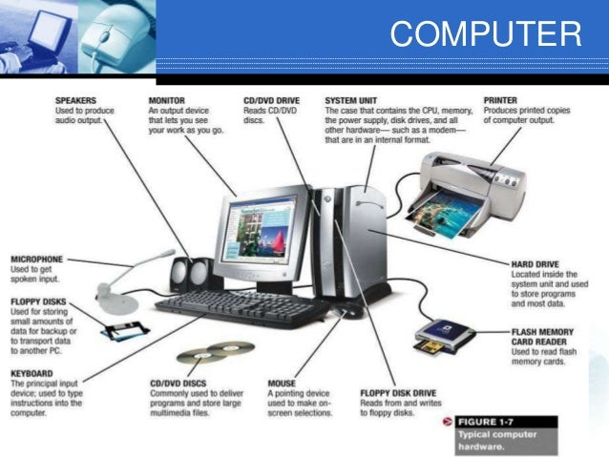
Computer hardware
Hardware refers to the physical, tangible computer equipment and devices, which provide support for major functions such as input, processing (internal storage, computation and control), output, secondary storage (for data and programs), and communication.

Slide 22
-These are devices used for entering data or instructions to the central processing unit and are classified according to the method they use to enter data.
INPUT DEVICES

Slide 23
Keyboard (similar to a typewriter) is the main input device of a computer . It contains three types of keys-- alphanumeric keys, special keys and function keys. Alphanumeric keys are used to type all alphabets, numbers and special symbols like $, %, @, A etc. Special keys such as <Shift>, <Ctrl>, <Alt>, <Home>, <Scroll Lock> etc. are used for special functions. Function keys such as <Fl>, <F2>, <F3> etc. are used to give special commands depending upon the software used e.g.F5 reloads a page of an internet browser. The function of each and every key can be well understood only after working on a PC. When any key is pressed, an electronic signal is produced. This signal is detected by a keyboard encoder that sends a binary code corresponding to the key pressed to the CPU. There are many types of keyboards but 101 keys keyboard is the most popular one.
a) KEYING DEVICES
Are devices used to enter data into the computer using a set of keys eg Keyboard, key-to- storage and keypad.

Slide 24
How the keys are organized

Slide 25
These keys include the same letter, number, punctuation, and symbol keys found on a traditional typewriter.
Typing (alphanumeric) keys

Slide 26
These keys are used alone or in combination with other keys to perform certain actions. The most frequently used control keys are CTRL, ALT, the Windows key, and ESC.
Special (Control) keys

Slide 27
The function keys are used to perform specific tasks. They are labelled as F1, F2, F3, and so on, up to F12. The functionality of these keys differs from program to program.
Function keys

Slide 28
These keys are used for moving around in documents or WebPages and editing text. They include the arrow keys, HOME, END, PAGE UP, PAGE DOWN, DELETE, and INSERT and ARROW KEYS.
Cursor Movement (Navigation) keys

Slide 29
The numeric keypad is handy for entering numbers quickly. The keys are grouped together in a block like a conventional calculator or adding machine.Related image
Numeric keypad

Slide 30
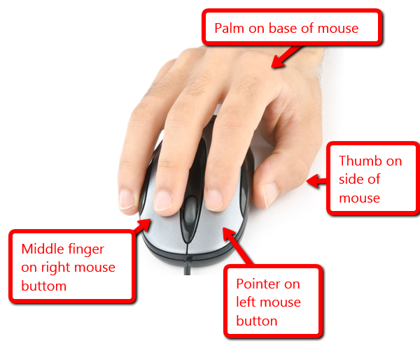
Mouse is a little gadget that allows you to point to and select items on your computer screen. Although mice appear in a variety of shapes, the common mouse does resemble a real mouse. It's small and oblong, and it's linked to the system unit by a long wire that looks like a tail and a connector that can be PS/2 or USB. Some of the more recent mice are wireless.A mouse typically has two buttons: one major (usually the left) and one secondary. Many mouse additionally contain a wheel between the two buttons that allows you to smoothly browse through information screens.
b) POINTING DEVICES
Are devices that enter data and instructions into the computer using a pointer that appears on the screen. The items to be entered are selected by either pointing to or clicking on them.e.g mice, joystick, touch sensitive screen, trackballs

Slide 31
four basic ways to use your mouse buttons

Slide 32
To click an item, point to the item on the screen, and then press and release the primary button (usually the left button). Clicking is most often used to select (mark) an item or open a menu. This is sometimes called single-clicking or left-clicking.
Clicking (single-clicking)

Slide 33
To double-click an item, point to the item on the screen, and then click twice quickly. If the two clicks are spaced too far apart, they might be interpreted as two individual clicks rather than as one double-click. Double-clicking is most often used to open items on your desktop. For example, you can start a program or open a folder by double-clicking its icon on the desktop.
Double-clicking

Slide 34
To right-click an item, point to the item on the screen, and then press and release the secondary button (usually the right button). Right-clicking an item usually displays a list of things you can do with the item. For example, when you right-click the Recycle Bin on your desktop, Windows displays a menu allowing you to open it, empty it, delete it, or see its properties. If you are unsure of what to do with something, right-click it.
Right-clicking

Slide 35
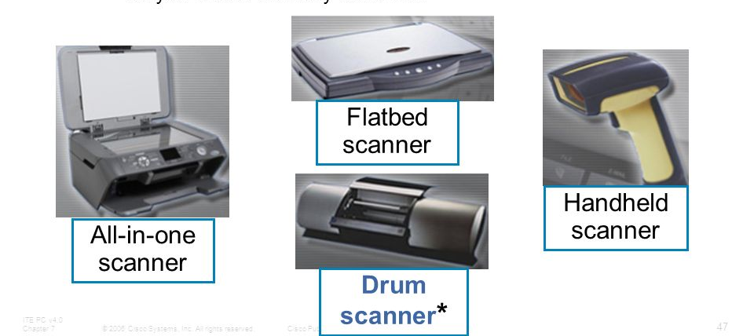
Scanner is a device that takes images from photographic prints, posters, magazine pages, and other similar sources for editing and display on a computer. Through optical character recognition, scanners turn the image on the document into digital information that can be saved on a computer (OCR).A scanning head performs this operation by capturing the image as light or electrical charges using one or more sensors. Depending on the type of scanner, the document scanner moves either the physical document or the scanning head. The scanner then processes the scanned image to create a digital image that can be saved on a computer.
c) SCANNING DEVICES
Are devices that capture an object or a document directly from the source. They are classifie according to the technology used to capture data e.g. Scanners and Document readers.

Slide 36
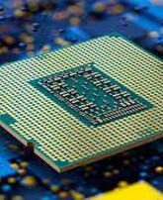
THE CENTRAL PROCESSING UNIT ( C P U)

Slide 37
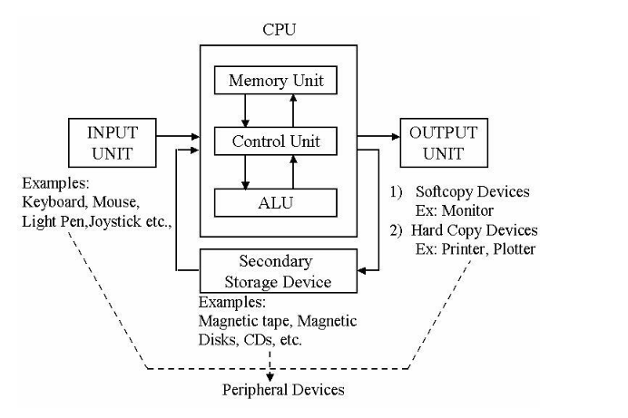
The Central Processing Unit is a computer's brain, including all of the circuitry required to process input, store data, and output results. The CPU is continually obeying computer program instructions that tell it which data to process and how to process it. We couldn't run applications on a computer without a CPU.
THE CENTRAL PROCESSING UNIT ( C P U)

Slide 38
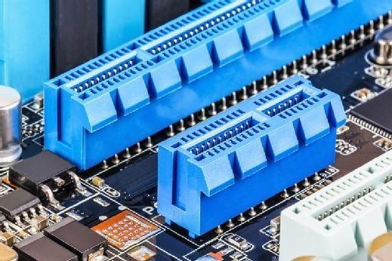
A motherboard is a computer's main printed circuit board (PCB). The motherboard is the central communications backbone connectivity point for all components and external peripherals in a computer. Motherboards are found in almost all computers, particularly desktop and laptop PCs. Chipsets, central processing units (CPU), and memory are among the components that connect through them. Wi-Fi, Ethernet, and graphics cards with the graphics processing unit, or GPU, are examples of external peripherals.Acer, ASRock, Asus, Gigabyte Technology, Intel, and Micro-Star International are among the motherboard manufacturers.
mOTHERBOARD

Slide 39
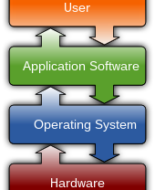
Computer software
also known as programs or applications. They are classified into two classes namely - sytem software and application software

Slide 40
Two types of software

Slide 41
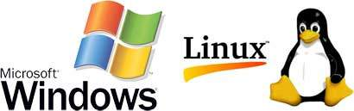
Software is a set of programs, which is designed to perform a well-defined function. A program is a sequence of instructions written to solve a particular problem. The system software is a collection of programs designed to operate, control, and extend the processing capabilities of the computer itself. System software is generally prepared by the computer manufacturers. These software products comprise of programs written in low-level languages, which interact with the hardware at a very basic level. System software serves as the interface between the hardware and the end users.
System software

Slide 42
List of some of the most prominent features of a system software Close to the system Fast in speed Difficult to design Difficult to understand Less interactive Smaller in size Difficult to manipulate Generally written in low-level language
System software

Slide 43
Application software products are created to meet a specific need in a specific environment. Application software encompasses all software applications developed in the computer lab. A single program, such as Microsoft's notepad for writing and editing simple text, can be considered application software. It could also be a collection of programs, known as a software package, that work together to complete a task, such as a spreadsheet package.
application software

Slide 44
Examples of Application software are the following Payroll Software Student Record Software Inventory Management Software Income Tax Software Railways Reservation Software Microsoft Office Suite Software Microsoft Word Microsoft Excel Microsoft PowerPoint
application
software

Slide 45
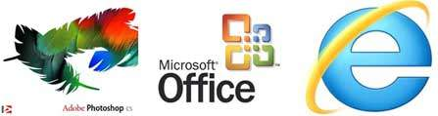
Features of application software are as follows Close to the user Easy to design More interactive Slow in speed Generally written in high-level language Easy to understand Easy to manipulate and use Bigger in size and requires large storage space
application
software

Slide 46
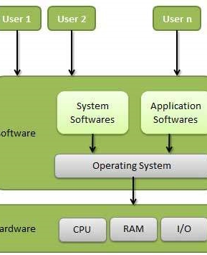
Operating system
An operating system (OS) is a type of system software that controls how computer hardware and software resources are used and offers basic services to other software applications. Operating systems that use time-sharing plan activities to make the most of the system's resources. They may also contain accounting software to allocate costs for processing time, mass storage, printing, and other resources. Although application code is typically performed directly by hardware and frequently makes system calls to an OS function or is interrupted by it, the operating system acts as a bridge between programs and the computer hardware for hardware functions like input and output and memory allocation. From mobile phones and video game consoles to web servers and supercomputers, many devices that house a computer have operating systems.

Slide 47
Types of Operating System
-Single Tasking and Multi-Tasking
- Single and Multi-user
- Distributed
- Embedded
- Real-time
- Library

Slide 48
Types of Operating System
Single Tasking and Multi-Tasking
A single-tasking system can only run one program at a time, while a multi-tasking operating system allows more than one program to be running concurrently. This is achieved by time-sharing, where the available processor time is divided between multiple processes. These processes are each interrupted repeatedly in time slices by a task-scheduling subsystem of the operating system. Multi-tasking may be characterized in preemptive and cooperative types. In preemptive multitasking, the operating system slices the CPU time and dedicates a slot to each of the programs. Unix-like operating systems, such as Linux—as well as non-Unix-like, such as AmigaOS—support preemptive multitasking. Cooperative multitasking is achieved by relying on each process to provide time to the other processes in a defined manner. 16-bit versions of Microsoft Windows used cooperative multi-tasking; 32-bit versions of both Windows NT and Win9x used preemptive multi-tasking.

Slide 49
Types of Operating System
Single and Multi-user
Single-user operating systems have no facilities to distinguish users but may allow multiple programs to run in tandem.^{[8]} A multi-user operating system extends the basic concept of multi-tasking with facilities that identify processes and resources, such as disk space, belonging to multiple users, and the system permits multiple users to interact with the system at the same time. Time-sharing operating systems schedule tasks for efficient use of the system and may also include accounting software for cost allocation of processor time, mass storage, printing, and other resources to multiple users.

Slide 50
Types of Operating System
Distributed
A distributed operating system manages a group of distinct, networked computers and makes them appear to be a single computer, as all computations are distributed (divided amongst the constituent computers).^{[9]}

Slide 51
Types of Operating System
Embedded
Embedded operating systems are designed to be used in embedded computer systems. They are designed to operate on small machines with less autonomy (e.g. PDAs). They are very compact and extremely efficient by design and are able to operate with a limited amount of resources. Windows CE and Minix 3 are some examples of embedded operating systems.

Slide 52
Types of Operating System
Real-time
A real-time operating system is an operating system that guarantees to process events or data by a specific moment in time. A real-time operating system may be single- or multi-tasking, but when multitasking, it uses specialized scheduling algorithms so that a deterministic nature of behavior is achieved. Such an event-driven system switches between tasks based on their priorities or external events, whereas time-sharing operating systems switch tasks based on clock interrupts.

Slide 53
Types of Operating System
Library
A library operating system is one in which the services that a typical operating system provides, such as networking, are provided in the form of libraries and composed with the application and configuration code to construct a unikernel: a specialized, single address space, machine image that can be deployed to cloud or embedded environments

Slide 54
Computer software: Operating system
What is operation system(OS)
kind of OS:
Service/Function provided by OS
Windows operating system
linux operating system

Slide 55
Operating System
- Examples

Slide 56
This is one of the most popular and commercial operating systems developed and marketed by Microsoft. It has different versions in the market like Windows 8, Windows 10 etc and most of them are paid.
Microsoft Windows

Slide 57
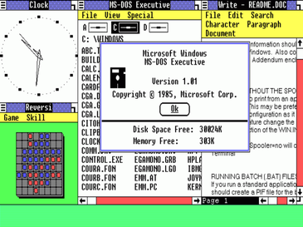
MICROSOFT WINDOWS
Windows 1.0 (first version) released in 1990

Slide 58
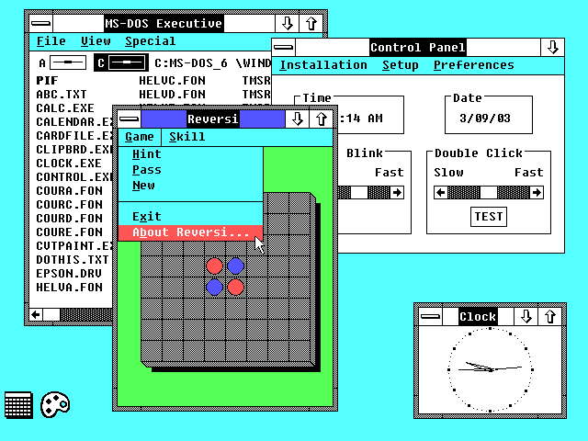
MICROSOFT WINDOWS
1987 Microsoft released Windows 2.0

Slide 59
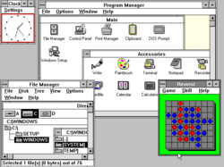
MICROSOFT WINDOWS
Windows 3.0 released in 1990

Slide 60
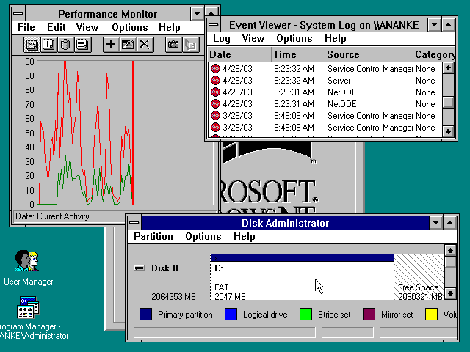
MICROSOFT WINDOWS
July 27, 1993
Windows NT (New Technology) was a 32-bit operating system that supported preemptive multitasking.

Slide 61
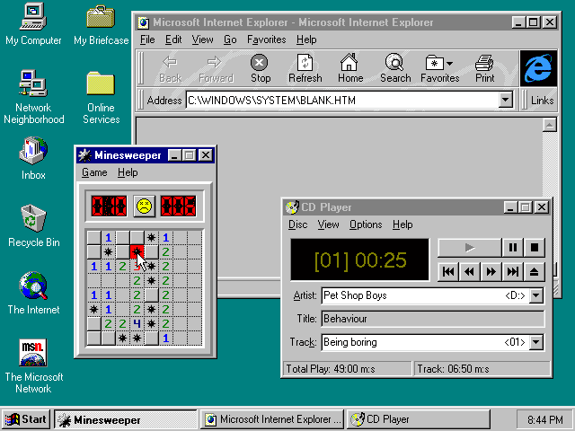
MICROSOFT WINDOWS
August 24, 1995
Windows 95 was a major upgrade to the Windows operating system.

Slide 62
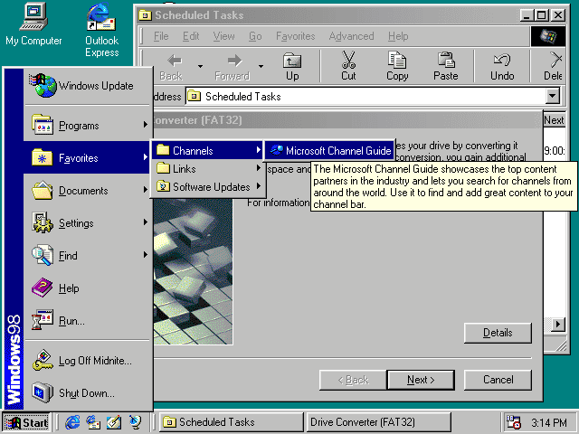
MICROSOFT WINDOWS
June 25, 1998
Windows 98 supported a number of new technologies, including FAT32, AGP, MMX, USB, DVD, and ACPI.

Slide 63
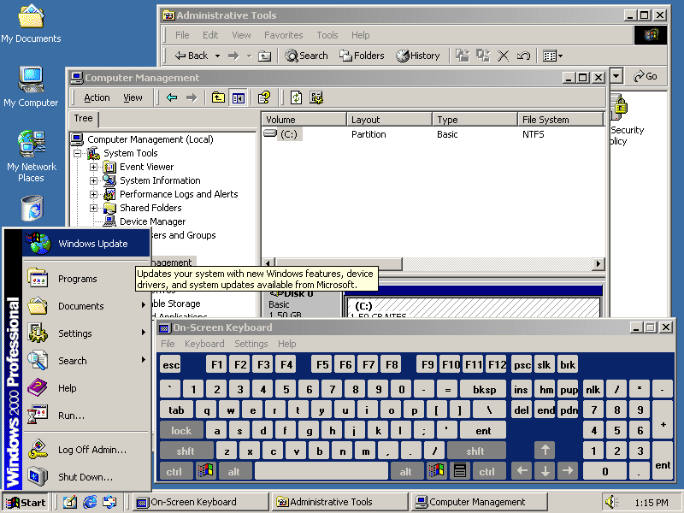
MICROSOFT WINDOWS
February 17, 2000
Often abbreviated as “W2K,” Windows 2000 was an operating system for business desktop and laptop systems to run software applications, connect to Internet and intranet sites, and access files, printers, and network resources.

Slide 64
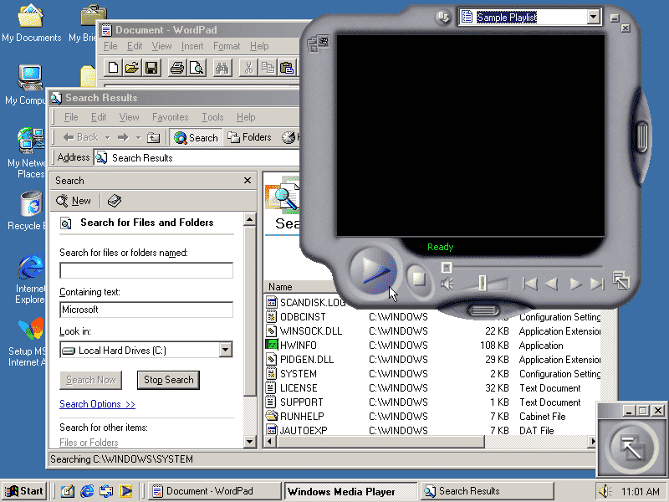
MICROSOFT WINDOWS
June 19, 2000
The Windows Millennium Edition, called “Windows Me”

Slide 65
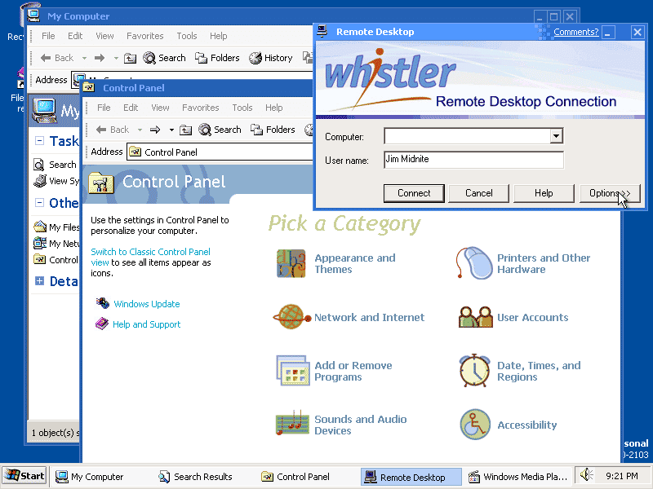
MICROSOFT WINDOWS
October 25, 2001
Windows XP was released in 2001. Along with a redesigned look and feel to the user interface, the new operating system was built on the Windows 2000 kernel, giving the user a more stable and reliable environment than previous versions of Windows.

Slide 66
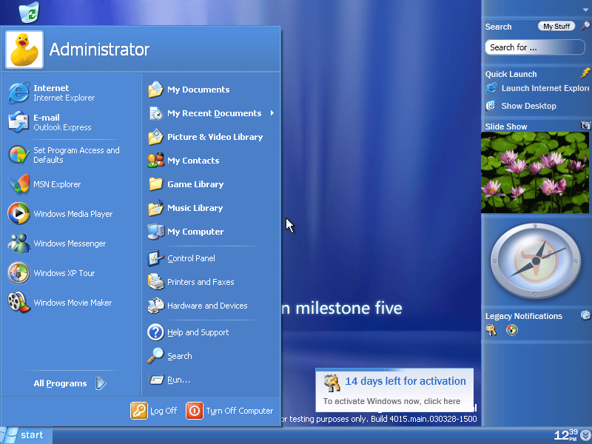
MICROSOFT WINDOWS
November 30, 2006 (corporate); January 30, 2007 (public)
Windows Vista offered an advancement in reliability, security, ease of deployment, performance and manageability over Windows XP.

Slide 67
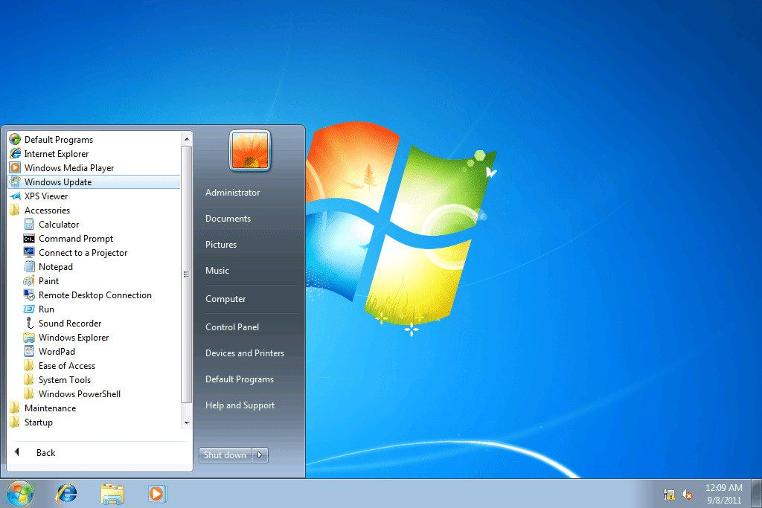
MICROSOFT WINDOWS
October 22, 2009
Windows 7 was released in conjunction with Windows Server 2008 R2, Windows 7’s server counterpart.

Slide 68
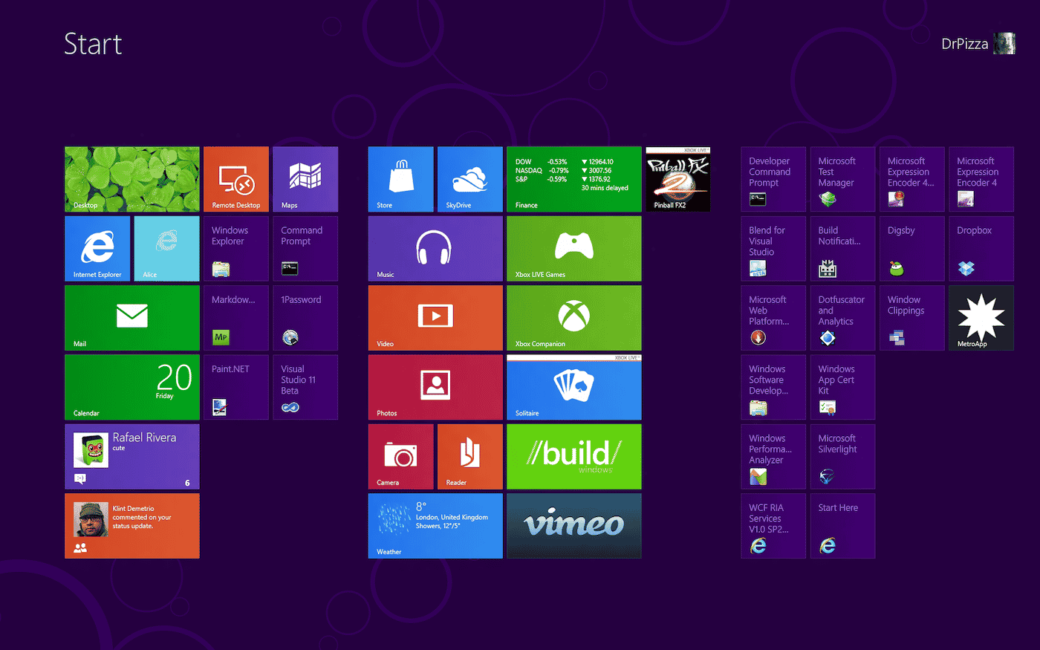
MICROSOFT WINDOWS
October 26, 2012
Windows 8 was a completely redesigned operating system that’s been developed from the ground up with touchscreen use in mind as well as near-instant-on capabilities that enable a Windows 8 PC to load and start up in a matter of seconds rather than in minutes.

Slide 69
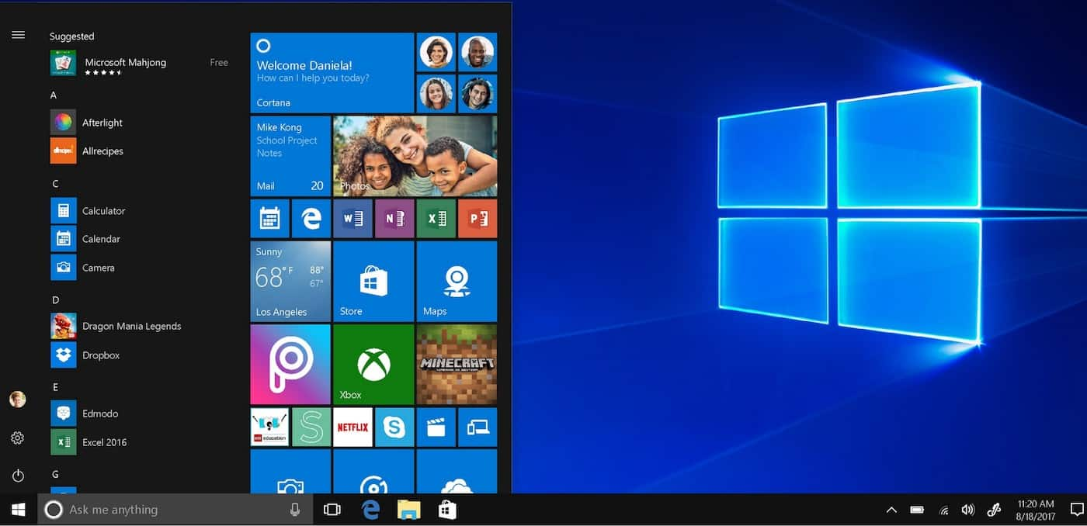
MICROSOFT WINDOWS
July 29, 2015
Windows 10 was the successor to Windows 8. Windows 10 debuted on July 29, 2015, following a “technical preview” beta release of the new operating system (Fall 2014) and a “consumer preview” beta (Early 2015).

Slide 70
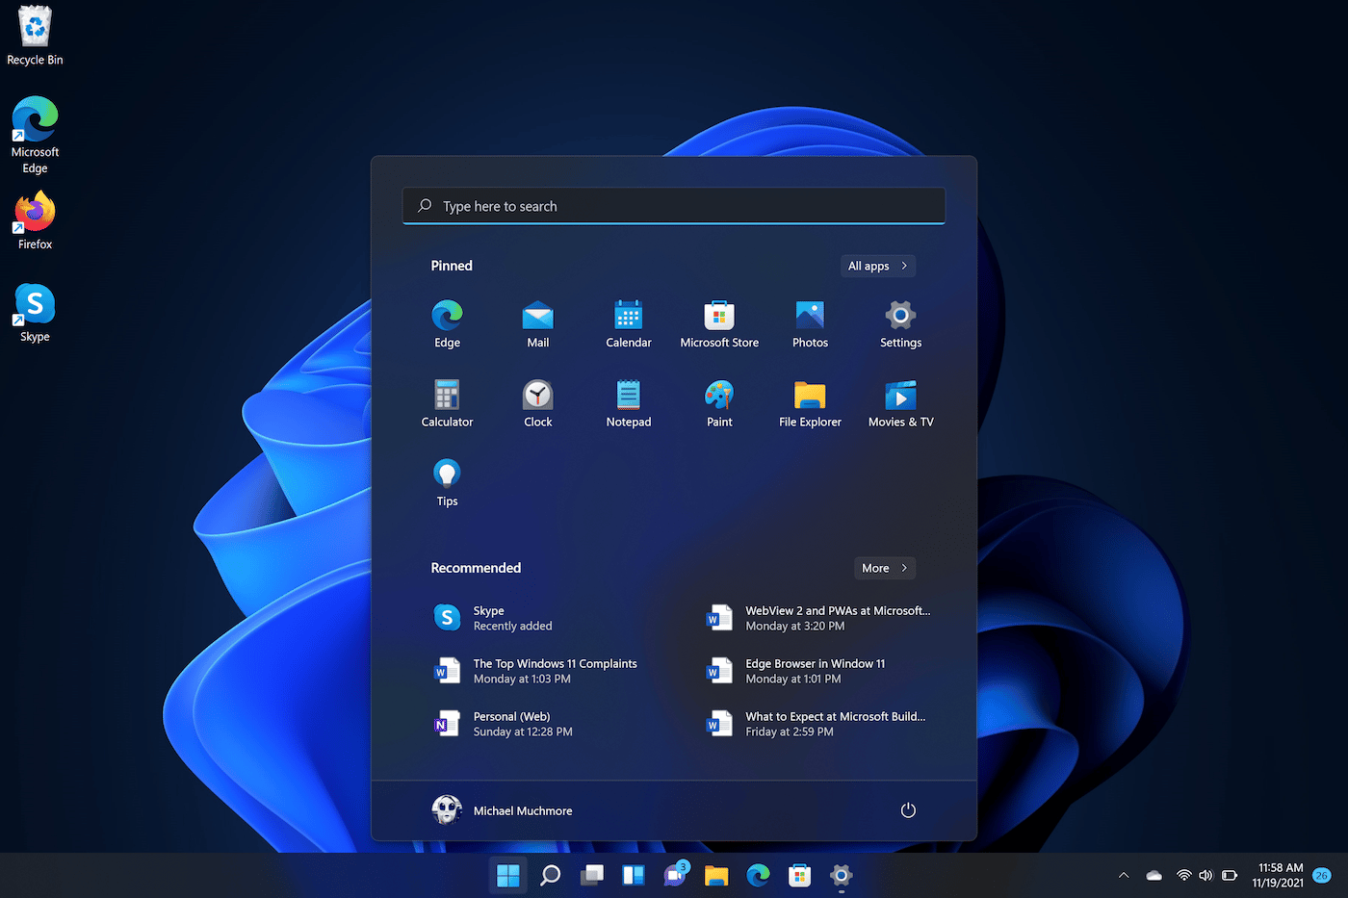
MICROSOFT WINDOWS
October 5, 2021
Though Microsoft claimed Windows 10 would be the last version of Windows ever, Windows 11 came with a new visual design, updated apps, touchscreen optimizations, and multitasking features.

Slide 71
This is a Unix based and the most loved operating system first released on September 17, 1991 by Linus Torvalds. Today, it has 30+ variants available like Fedora, OpenSUSE, CentOS, UBuntu etc. Most of them are available free of charges though you can have their enterprise versions by paying a nominal license fee.
Linux

Slide 72
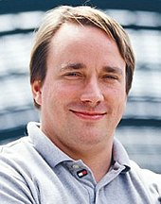
Linus Torvalds, principal author of the Linux

Slide 73
Linux: Precursors
The Unix operating system was conceived and implemented in 1969, at AT&T's Bell Labs, in the United States by Ken Thompson, Dennis Ritchie, Douglas McIlroy, and Joe Ossanna.^{[40]} First released in 1971, Unix was written entirely in assembly language, as was common practice at the time. In 1973, in a key pioneering approach, it was rewritten in the C programming language by Dennis Ritchie (with the exception of some hardware and I/O routines). The availability of a high-level language implementation of Unix made its porting to different computer platforms easier.^{[4}
Onyx Systems began selling early microcomputer-based Unix workstations in 1980. Later, Sun Microsystems, founded as a spin-off of a student project at Stanford University, also began selling Unix-based desktop workstations in 1982.

Slide 74
Linux: Creation
While attending the University of Helsinki in the fall of 1990, Torvalds enrolled in a Unix course.^{[51]} The course utilized a MicroVAX minicomputer running Ultrix, and one of the required texts was Operating Systems: Design and Implementation by Andrew S. Tanenbaum. This textbook included a copy of Tanenbaum's MINIX operating system. It was with this course that Torvalds first became exposed to Unix. In 1991, he became curious about operating systems.^{[52]} Frustrated by the licensing of MINIX, which at the time limited it to educational use only,^{[48]} he began to work on his own operating system kernel, which eventually became the Linux kernel.
Torvalds began the development of the Linux kernel on MINIX and applications written for MINIX were also used on Linux. Later, Linux matured and further Linux kernel development took place on Linux systems.

Slide 75
Linux: NAming
Linus Torvalds had wanted to call his invention "Freax", a portmanteau of "free", "freak", and "x" (as an allusion to Unix). During the start of his work on the system, some of the project's makefiles included the name "Freax" for about half a year. Initially, Torvalds considered the name "Linux" but dismissed it as too egotistical

Slide 76
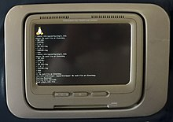
Linux: Design
The Linux kernel was not created; rather, it evolved through natural selection, according to several open source developers. Linux, according to Torvalds, "grew with a lot of mutations — and because the changes were less than random, they were faster and more directed than alpha-particles in DNA," even if the Unix design functioned as a scaffolding. [71] According to Eric S. Raymond, the social, not the technical, features of Linux are revolutionary. Prior to Linux, complicated software was painstakingly created by small teams, but "Linux evolved in a completely different way. It was almost immediately casually hacked on by a sizable number of volunteers who could only communicate online.

Slide 77
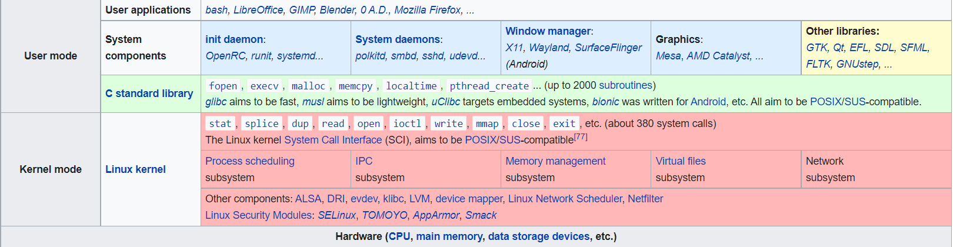
Various layers within Linux, also showing separation between the userland and kernel space

Slide 78
Installed components of a Linux system include the following:
- A bootloader, for example GNU GRUB, LILO, SYSLINUX or systemd-boot.
- An init program, such as the traditional sysvinit and the newer systemd, OpenRC and Upstart.
- Software libraries, which contain code that can be used by running processes.
- C standard library is the library needed to run C programs on a computer system, with the GNU C Library being the standard.
- Basic Unix commands, with GNU coreutils being the standard implementation.
- Widget toolkits are the libraries used to build graphical user interfaces (GUIs) for software applications.
- A package management system, such as dpkg and RPM.
-

Slide 79
User interface
The user interface, commonly referred to as the shell, can be a hardware control attached to the accompanying hardware, a command-line interface (CLI), a graphical user interface (GUI), or both. The default user interface for desktop systems is typically graphical, while the CLI is frequently accessible through terminal emulator windows or on a different virtual console.
Text is used for both input and output in CLI shells, which are text-based user interfaces. The Bourne-Again Shell (bash), created initially for the GNU project, is the most popular shell used in Linux. The majority of Linux's low-level components, including different userland components, only use the CLI. The CLI offers incredibly straightforward inter-process communication and is especially well suited for automating repetitive or delayed operations.

Slide 80
Programming on Linux
The majority of programming languages offer support for Linux, either directly or via community-based third-party ports. [98] The GNU toolchain, which consists of the GNU Compiler Collection (GCC) and the GNU Build System, contains the original development tools used to create both Linux applications and operating system programs.
GCC offers compilers for Ada, C, C++, Go, and Fortran, among other languages. Many programming languages, including PHP, Perl, Ruby, Python, Java, Go, Rust, and Haskell, have cross-platform reference implementations that support Linux. The LLVM project offers an alternative cross-platform open-source compiler for various languages that was first released in 2003. The Intel C++ Compiler, Sun Studio, and IBM XL C/C++ Compiler are examples of proprietary compilers for Linux.

Slide 81
Linux: Hardware support
The Linux kernel is a widely ported operating system kernel that can run on a wide variety of hardware, including handheld ARM-based iPAQs and IBM mainframes System z9 or System z10.
It is available for devices ranging from smartphones to supercomputers. For less common architectures, specialized distributions and kernel forks are available; for instance, the ELKS kernel fork can be used with Intel 8086 or Intel 80286 16-bit microprocessors, and the Clinux kernel fork can be used with systems lacking a memory management unit.
Additionally, the kernel can be used on platforms that were only ever designed to run proprietary operating systems, such PDAs, gaming consoles, portable media players, mobile phones, and Macintosh computer (with both PowerPC and Intel processors).

Slide 82
Below are some of the most common Linux distributions such as:
Debian.
Fedora.
Mandriva Linux.
openSUSE.
Arch Linux.
Gentoo.
Slackware.
Ubuntu.

Slide 83

Linux distributions Debian GNU/Linux
Debian GNU/Linux
Debian, also known as Debian GNU/Linux, is a Linux distribution composed of free and open-source software, developed by the community-supported Debian Project, which was established by Ian Murdock on August 16, 1993.

Slide 84

Linux distributions Fedora
Fedora Linux is a Linux distribution developed by the Fedora Project. Fedora contains software distributed under various free and open-source licenses and aims to be on the leading edge of open-source technologies. Fedora is the upstream source for Red Hat Enterprise Linux.

Slide 85

Linux distributions Mandriva Linux
Mandriva Linux is a discontinued Linux distribution developed by Mandriva S.A. Each release lifetime was 18 months for base updates and 12 months for desktop updates. Server products received full updates for at least five years after their release. The last release of Mandriva Linux was in August 2011.

Slide 86

Linux distributions openSUSE
openSUSE is a free and open source RPM-based Linux distribution developed by the openSUSE project. The initial release of the community project was a beta version of SUSE Linux 10.0.

Slide 87

Linux distributions Arch Linux
Arch Linux is an independently developed, x86-64 general-purpose Linux distribution that strives to provide the latest stable versions of most software by following a rolling-release model. The default installation is a minimal base system, configured by the user to only add what is purposely required.

Slide 88

Linux distributions Gentoo Linux
Gentoo Linux is a Linux distribution built using the Portage package management system. Unlike a binary software distribution, the source code is compiled locally according to the user's preferences and is often optimized for the specific type of computer.

Slide 89
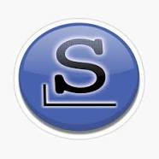
Linux distributions Slackware
Slackware is a Linux distribution created by Patrick Volkerding in 1993. Originally based on Softlanding Linux System, Slackware has been the basis for many other Linux distributions, most notably the first versions of SUSE Linux distributions, and is the oldest distribution that is still maintained.

Slide 90
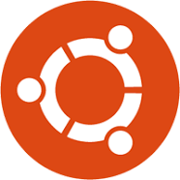
Linux distributions Ubuntu
Ubuntu is a Linux distribution based on Debian and composed mostly of free and open-source software. Ubuntu is officially released in three editions: Desktop, Server, and Core for Internet of things devices and robots. All of the editions can run on the computer alone, or in a virtual machine.

Slide 91
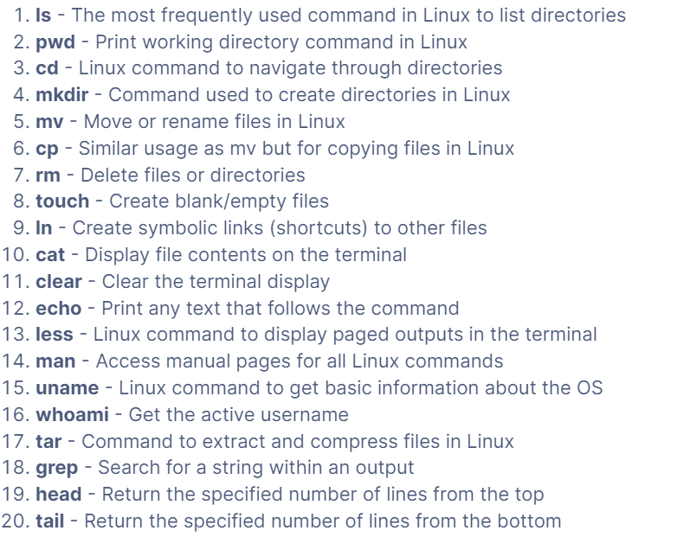
Top 50 Linux Commands You Must Know as a Regular User

Slide 92
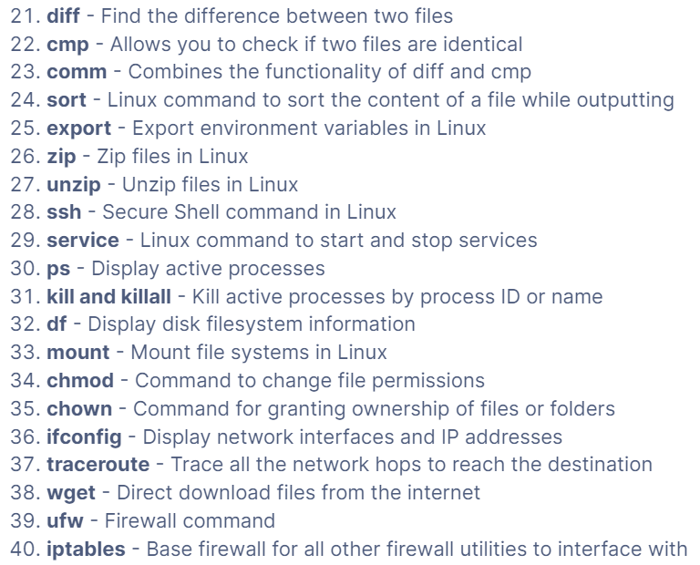
Top 50 Linux Commands You Must Know as a Regular User

Slide 93
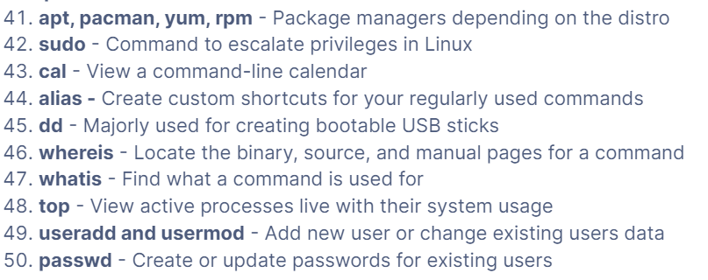
Top 50 Linux Commands You Must Know as a Regular User

Slide 94
This is again a kind of Unix operating system developed and marketed by Apple Inc. since 2001.
MacOS

Slide 95
This is a mobile operating system created and developed by Apple Inc. exclusively for its mobile devices like iPhone and iPad etc.
iOS

Slide 96
This is a mobile Operating System based on a modified version of the Linux kernel and other open source software, designed primarily for touchscreen mobile devices such as smartphones and tablets.
Android

Slide 97
Android History and development
Android began its life as a Palo Alto-based startup company called Android Inc., in 2003. Originally, the company set out to develop an operating system for digital cameras, but it abandoned those efforts in lieu of reaching a broader market.
Google acquired Android Inc. and its key employees in 2005 for at least $50 million. Google marketed the early mobile platform to handset manufacturers and mobile carriers with its major benefits as flexibility and upgradability.
THIS ARTICLE IS PART OF

Slide 98
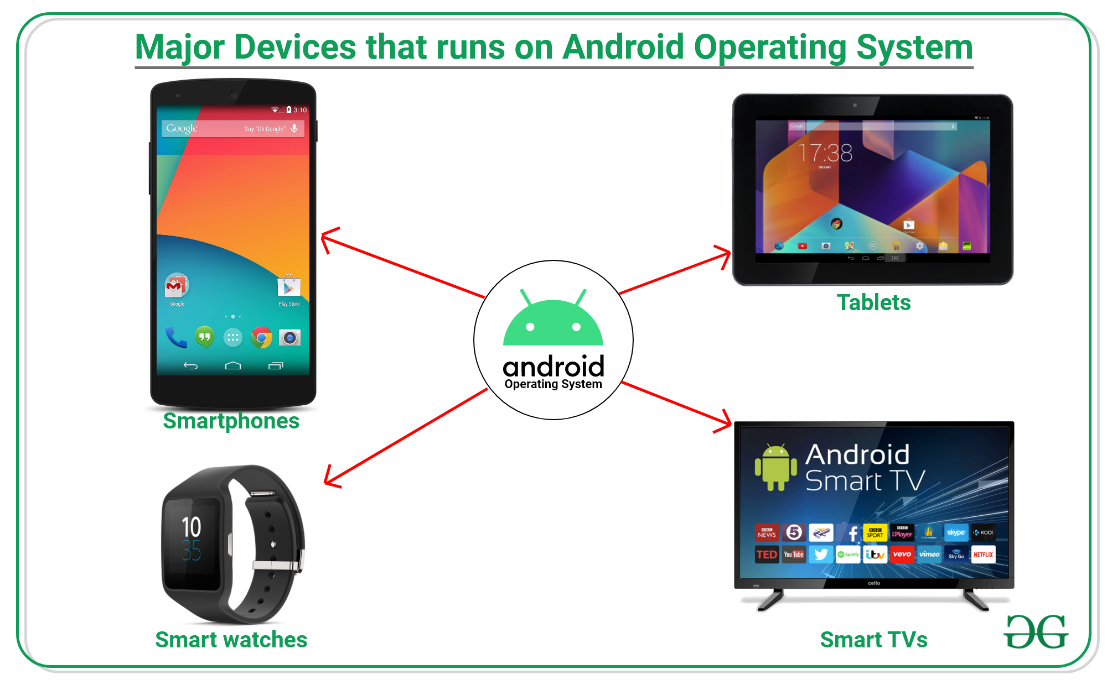

Slide 99
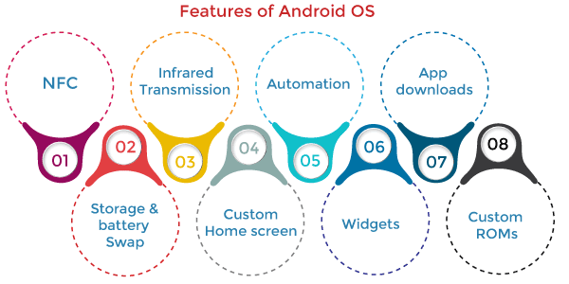

Slide 100
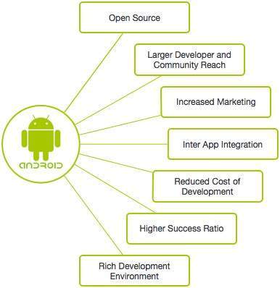
Android: Overview

Slide 101
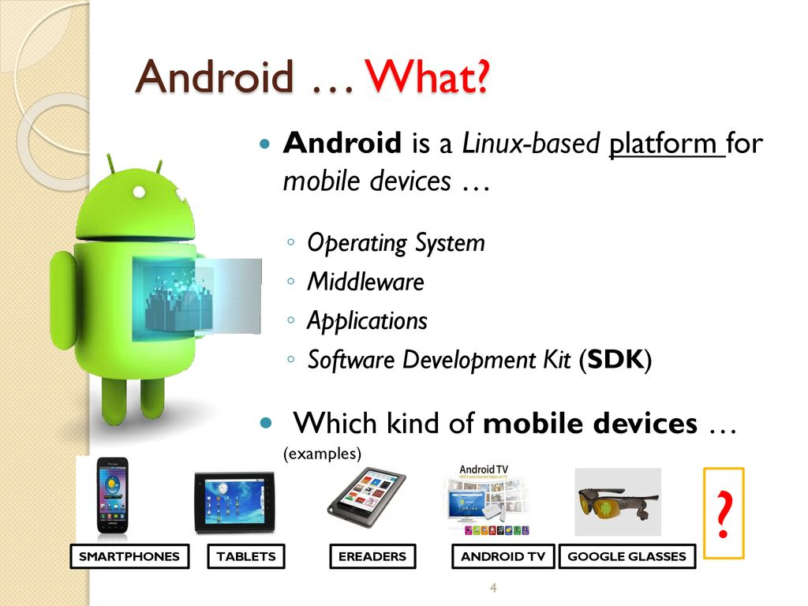
ANDROID ARCHITECTURE

Slide 102
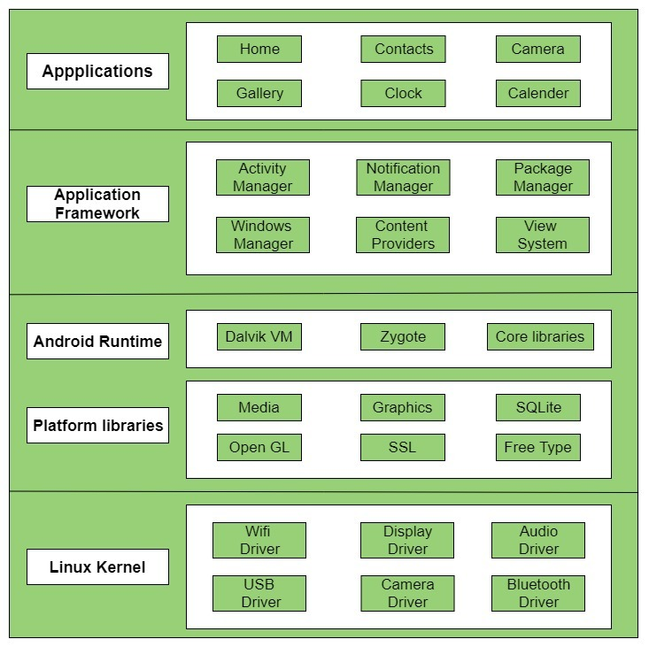
ANDROID ARCHITECTURE

Slide 103
Version of Androids
KITKAT (4.4)
JELLY BEAN (4.1 – 4.3)
ICE CREAM SANDWICH (4.0)
HONEY COMB (3.0 – 3.2)
GINGERBREAD (2.3)
FROYO (2.2)
ÉCLAIR (2.0 – 2.1)
DONUT (1.6)
CUPCAKE (1.5)
The Early Days (1.0 – 1.1)
Tiramisu (OS 13)
Snow Cone (OS 12)
Red Velvet Cake (OS 11)
Quince Tart (OS 10)
Pie (9.0)
Oreo (8.0)
Nougat (7.0)
Marshmallow (6.0)
lollipop (5.0)

Slide 104
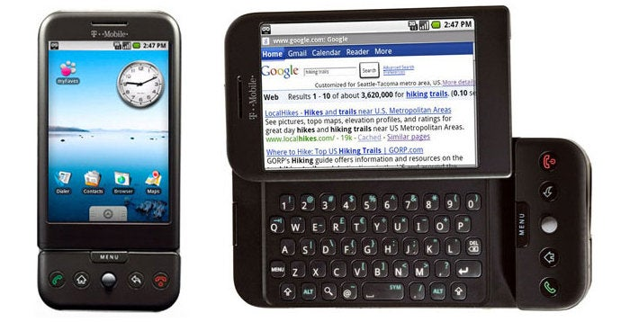
Android version The Early Days (1.0 – 1.1)

Slide 105
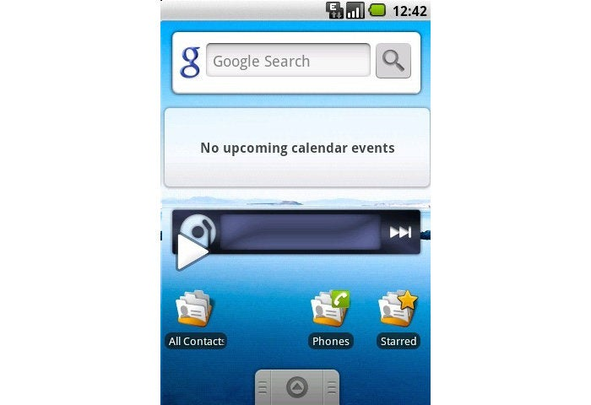
Android version CUPCAKE (1.5)

Slide 106
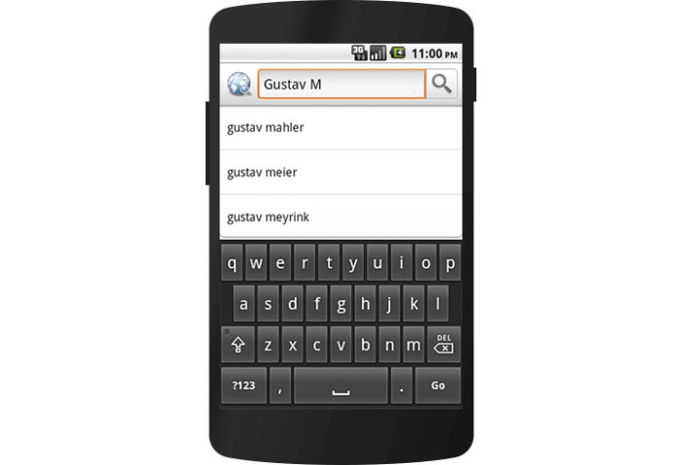
Android version DONUT (1.6)

Slide 107
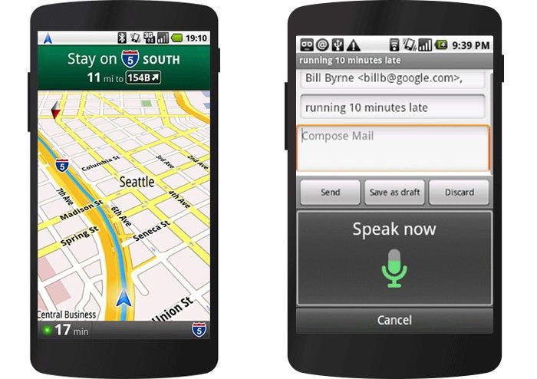
Android version ÉCLAIR (2.0 – 2.1)

Slide 108
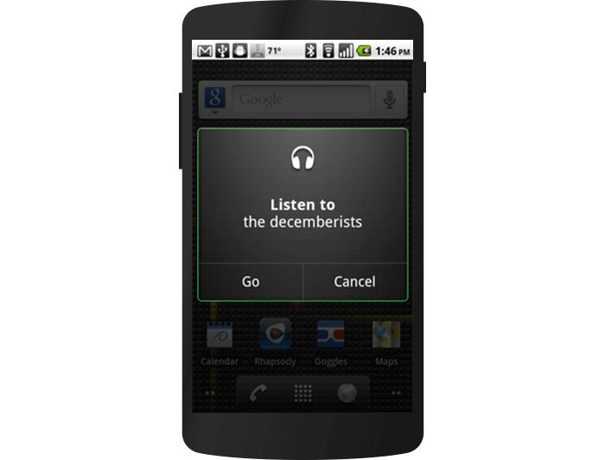
Android version FROYO (2.2)

Slide 109
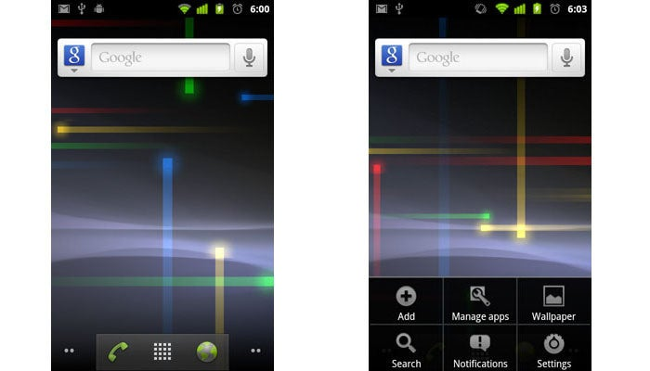
Android version GINGERBREAD (2.3)

Slide 110
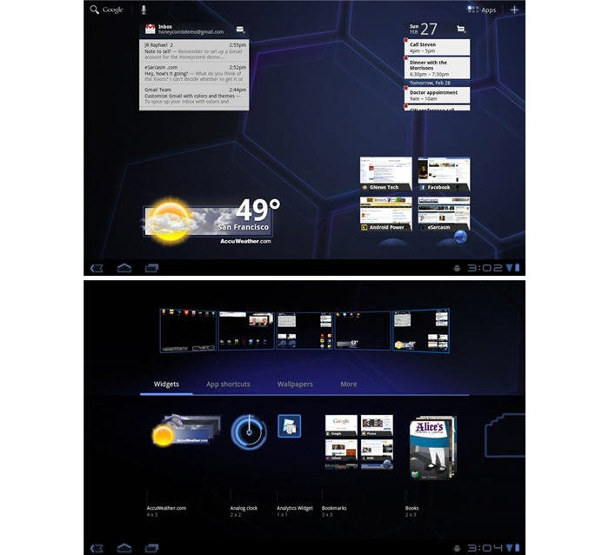
Android version HONEY COMB (3.0 – 3.2)

Slide 111
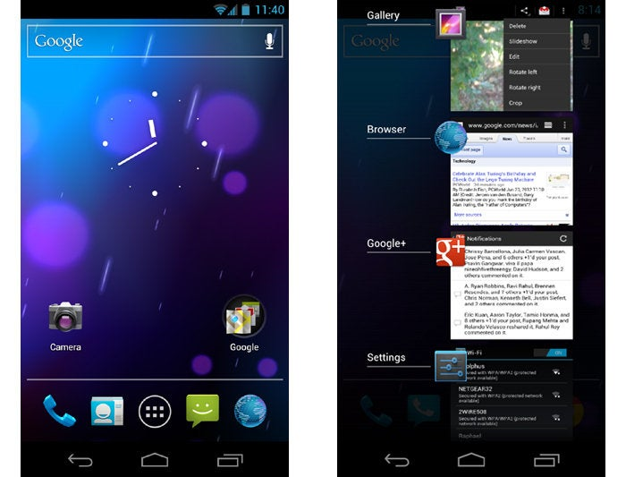
Android version ICE CREAM SANDWICH (4.0)

Slide 112
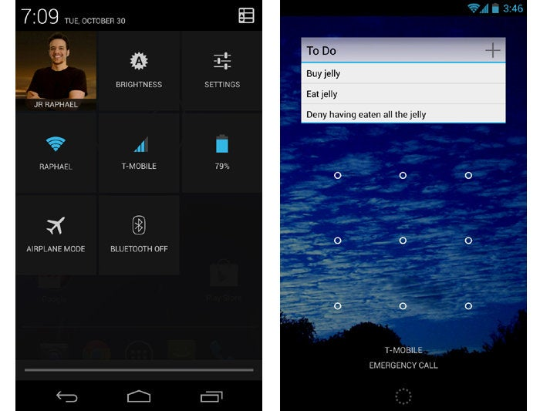
Android version JELLY BEAN (4.1 – 4.3)

Slide 113
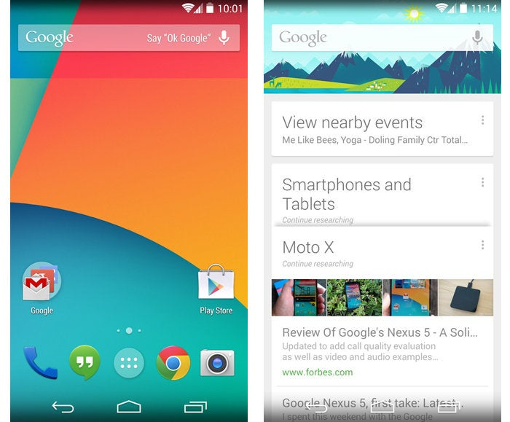
Android version KITKAT (4.4)

Slide 114

Android version lollipop (5.0)

Slide 115

Android version Marshmallow (6.0)

Slide 116

Android version Nougat (7.0)

Slide 117

Android version Oreo (8.0)

Slide 118

Android version Pie (9.0)

Slide 119

Android version Quince Tart (OS 10)

Slide 120

Android version Red Velvet Cake (OS 11)

Slide 121

Android version Snow Cone (OS 12)

Slide 122

Android version
Tiramisu (OS 13)

Slide 123
Operating System
- functions

Slide 124
To brief, Following are some of important functions of an operating System which we will look in more detail in upcoming chapters: Process Management I/O Device Management File Management Network Management Main Memory Management Secondary Storage Management Security Management Command Interpreter System Control over system performance Job Accounting Error Detection and Correction Coordination between other software and users Many more other important tasks
Operating System
- Functions

Slide 125
Operating System
- history

Slide 126
Operating systems have evolved over the years. In the 1950s, computers were limited to running one program at a time, similar to a calculator, but over the next few decades, computers began to include an increasing number of software programs, sometimes referred to as libraries, which formed the foundation for today's operating systems. General Motors created the first operating system, the IBM 704, in 1956 to run a single IBM mainframe computer. In the 1960s, IBM was the first computer manufacturer to create and distribute operating systems.
Operating Systems
- History

Slide 127
Stanford Research Institute developed the oN-Line System (NLS) in the late 1960s, which was the first operating system that resembled the desktop operating system we use today. Microsoft bought QDOS (Quick and Dirty Operating System) in 1981 and branded it as Microsoft Operating System (MS-DOS). As of 1994, Microsoft had stopped supporting MS-DOS. Unix was developed in the mid-1960s by the Massachusetts Institute of Technology, AT&T Bell Labs, and General Electric as a joint effort. Initially it was named MULTICS, which stands for Multiplexed Operating and Computing System. FreeBSD is also a popular UNIX derivative, originating from the BSD project at Berkeley. All modern Macintosh computers run a modified version of FreeBSD (OS X). Windows 95 is a consumer-oriented graphical user interface-based operating system built on top of MS-DOS. It was released on August 24, 1995 by Microsoft as part of its Windows 9x family of operating systems. Solaris is a proprietary Unix operating system originally developed by Sun Microsystems in 1991. After the Sun acquisition by Oracle in 2010 it was renamed Oracle Solaris.
Operating Systems
- History

Slide 128
Why to Learn Operating System

Slide 129
If you want to be a great computer programmer, you should first understand how an operating system works from the inside out. This allows you to understand how data is saved to disk, how different processes are created and scheduled to run by the CPU, and how to interact with various I/O devices and ports. There are several low-level concepts that can assist a programmer in designing and developing scalable software. Bottom line: Without a solid understanding of Operating System concepts, it is impossible to imagine someone becoming a good Computer Application Software developer, and it is even more difficult to imagine someone becoming a System Software developer.

Slide 130
Memory hierarchy

Slide 131

Memory hierarchy
The memory hierarchy in computer architecture categorizes computer storage according to reaction time. Due to the relationships between reaction time, complexity, and capacity, the levels can also be separated based on their performance and regulating methods. [1] Performance in algorithm predictions, lower level programming constructs requiring locality of reference, and computer architectural design are all impacted by memory hierarchy. The size and capabilities of each component must be taken into account while designing for high performance in order to work within the constraints of the memory hierarchy. Each component can be thought of as a member of a hierarchy of memory (m1, m2,..., mn), each of which is smaller and faster than the mi+1 member above it in the hierarchy.

Slide 132
four major storage levels

Slide 133
-Internal – Processor registers and cache. -Main – the system RAM and controller cards. -On-line mass storage – Secondary storage. -Off-line bulk storage – Tertiary and Off-line storage.
four major
storage levels

Slide 134

Properties of the technologies in the memory hierarchy
Adding complexity slows down the memory hierarchy.
CMOx memory technology stretches the Flash space in the memory hierarchy.
One of the main ways to increase system performance is minimising how far down the memory hierarchy one has to go to manipulate data
Latency and bandwidth are two metrics associated with caches. Neither of them is uniform, but is specific to a particular component of the memory hierarchy.[5]
Predicting where in the memory hierarchy the data resides is difficult.
...the location in the memory hierarchy dictates the time required for the prefetch to occur.

Slide 135
What is RAM?

Slide 136

RAM - random access memory
RAM (random access memory) is a computer's short-term memory, where the data that the processor is currently using is stored. Your computer can access RAM memory much faster than data on a hard disk, SSD, or other long-term storage device, which is why RAM capacity is critical for system performance.

Slide 137

RAM stands for random access memory, and it’s one of the most fundamental elements of computing. RAM is a temporary memory bank where your computer stores data it needs to retrieve quickly. RAM keeps data easily accessible so your processor can quickly find it without having to go into long-term storage to complete immediate processing tasks. Every computing device has RAM, whether it’s a desktop computer (running Windows, MacOS, or Linux), a tablet or smartphone (running Android or iOS), or even an IoT computing device (like a smart TV). Nearly all computers have a way of storing information for longer-term access, too. But the memory needed to run the process you’re currently working on is stored and accessed in your computer’s RAM.
What does RAM stand for?

Slide 138
RAM is used for immediate data storage and retrieval. Your RAM can process information significantly faster than data on a hard disk — twenty to a hundred times faster, depending on the specific hardware and task. To accomplish a specific task, computer operating systems load data from the hard disk into RAM to process it. When it’s finished actively working with that data, the computer converts it back into long-term storage. When you open a program such as Microsoft Word, your computer loads the application into its RAM. If you open a document you already have saved on your computer, your operating system locates the file in long-term storage and copies the information onto its RAM. Once the data is in your RAM, you get near-instantaneous performance because RAM is lightning fast.
What is RAM used for?

Slide 139
What is ROM?

Slide 140

ROM - random ONLY memory
Read-only memory, or ROM, is a type of computer storage containing non-volatile, permanent data that, normally, can only be read, not written to. ROM contains the programming that allows a computer to start up or regenerate each time it is turned on. ROM also performs large input/output (I/O) tasks and protects programs or software instructions. Once data is written on a ROM chip, it cannot be removed.
Almost every computer incorporates a small amount of ROM that contains the start-up firmware. This boot firmware is called the basic input/output system (BIOS). This software consists of code that instructs the boot-up processes for the computer -- such as loading the operating system (OS) into the random access memory (RAM) or running hardware diagnostics. Consequently, ROM is most often used for firmware updates

Slide 141
Difference between RAM and ROM

Slide 142
Difference between RAM and ROM
RAM
Random Access Memory (RAM) is used to store the programs and data being used by the CPU in real-time. The data on the random access memory can be read, written, and erased any number of times. RAM is a hardware element where the data being currently used is stored. It is a volatile memory. Types of RAM:

Slide 143
Random Access Memory (RAM)
Static RAM, or (SRAM) which stores a bit of data using the state of a six transistor memory cell.
Dynamic RAM, or (DRAM) which stores a bit data using a pair of transistor and capacitor which constitute a DRAM memory cell.

Slide 144
Read Only Memory (ROM)
is a type of memory where the data has been prerecorded. Data stored in ROM is retained even after the computer is turned off ie, non-volatile.

Slide 145
Read Only Memory (ROM)
Programmable ROM, where the data is written after the memory chip has been created. It is non-volatile.
Erasable Programmable ROM, where the data on this non-volatile memory chip can be erased by exposing it to high-intensity UV light.
Electrically Erasable Programmable ROM, where the data on this non-volatile memory chip can be electrically erased using field electron emission.
Mask ROM, in which the data is written during the manufacturing of the memory chip.

Slide 146

Difference between RAM and ROM

Slide 147
Difference between SRAM and DRAM

Slide 148
What is SRAM?
Static random-access memory (static RAM or SRAM) is a type of random-access memory (RAM) that uses latching circuitry (flip-flop) to store each bit. SRAM is volatile memory; data is lost when power is removed.
The term static differentiates SRAM from DRAM (dynamic random-access memory) — SRAM will hold its data permanently in the presence of power, while data in DRAM decays in seconds and thus must be periodically refreshed. SRAM is faster than DRAM but it is more expensive in terms of silicon area and cost; it is typically used for the cache and internal registers of a CPU while DRAM is used for a computer's main memory.

Slide 149
What is a DRAM?
Dynamic random-access memory
- is a type of random-access semiconductor memory that stores each bit of data in a memory cell, usually consisting of a tiny capacitor and a transistor, both typically based on metal-oxide-semiconductor (MOS) technology. While most DRAM memory cell designs use a capacitor and transistor, some only use two transistors. In the designs where a capacitor is used, the capacitor can either be charged or discharged; these two states are taken to represent the two values of a bit, conventionally called 0 and 1. The electric charge on the capacitors gradually leaks away; without intervention the data on the capacitor would soon be lost. To prevent this, DRAM requires an external memory refresh circuit which periodically rewrites the data in the capacitors, restoring them to their original charge. This refresh process is the defining characteristic of dynamic random-access memory, in contrast to static random-access memory (SRAM) which does not require data to be refreshed. Unlike flash memory, DRAM is volatile memory (vs. non-volatile memory), since it loses its data quickly when power is removed. However, DRAM does exhibit limited data remanence.

Slide 150
DRAM is usually arranged in a rectangular array of charge storage cells consisting of one capacitor and transistor per data bit. The figure to the right shows a simple example with a four-by-four cell matrix. Some DRAM matrices are many thousands of cells in height and width.^{[26][27]} The long horizontal lines connecting each row are known as word-lines. Each column of cells is composed of two bit-lines, each connected to every other storage cell in the column (the illustration to the right does not include this important detail). They are generally known as the "+" and "−" bit lines. A sense amplifier is essentially a pair of cross-connected inverters between the bit-lines. The first inverter is connected with input from the + bit-line and output to the − bit-line. The second inverter's input is from the − bit-line with output to the + bit-line. This results in positive feedback which stabilizes after one bit-line is fully at its highest voltage and the other bit-line is at the lowest possible voltage.
Dynamic random-access memory Principles of operation

Slide 151
The main difference between SRAM and DRAM is that SRAM is a type of memory chip that is both quicker and more energy-efficient than DRAM. However, DRAM is a memory chip that can store more data than SRAM but consumes more power. And is a type of on-chip memory with a short access time, whereas DRAM is an off-chip memory with a long access time. As a result, SRAM outperforms DRAM.
Difference between DRAM and SRAM

Slide 152

Difference between sram and dram

Slide 153
https://peda.net/kenya/ass/subjects2/computer-studies/form-1/the-computer-system
https://www.techopedia.com/definition/593/computer-system
https://en.wikipedia.org/wiki/Computer
https://www.techtarget.com/whatis/definition/SRAM-static-random-access-memory#:~:text=SRAM%20(static%20RAM)%20is%20a,performance%20and%20lower%20power%20usage.
https://en.wikipedia.org/wiki/Von_Neumann_architecture
https://en.wikipedia.org/wiki/Memory_hierarchy
rEFERENCES

